Slide 1
Simulation IE 406/408

Slide 2
Mohammad Ramshani
Background
Tehran, Iran

Slide 3
Mohammad Ramshani
Hobbies
Video Games (SC, W0W)
Food
Sleep (workout?)
Yodeling

Slide 4
Meet Your TAs: Mohammad Ramshani
Academic History
Tafresh University, IE BS
Kharazmi University, Systems Engineering MS
UT Ph.D student since Fall 2015
Research
Urban energy sustainability
Photovoltaic panels, Lithium-Ion batteries, Green roofs,
Supply chain
Mathematical programming, Simulation, Reinforcement learning

Slide 5
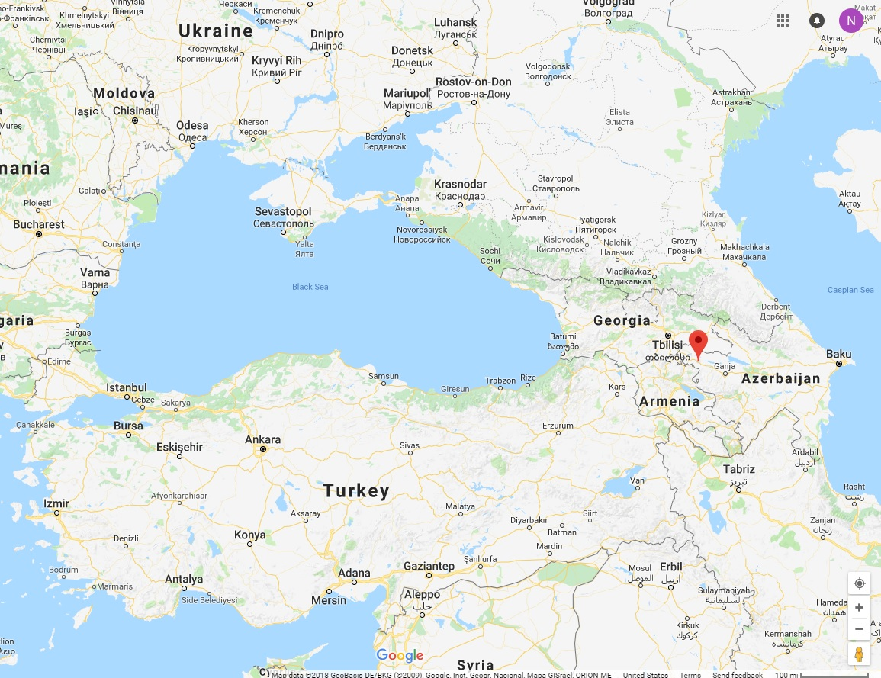
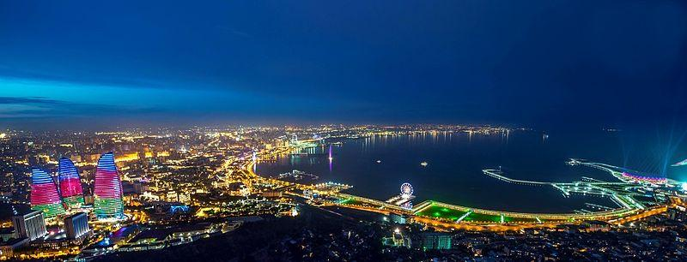
Meet Your TA: Najmaddin Akhundov
Home Country
Azerbaijan

Slide 6
Meet Your TA:
Najmaddin Akhundov
Academic History
Baku Engineering University, Azerbaijan, IE, BS (2006-2011)
University of Waterloo, Canada, SDE, MASc
(2013-2015)
New Jersey Institute of Technology (NJIT), USA, IE, PhD(2017-2018)
UT Ph.D student since Fall 2018
(2018-?)
Research
Advisor: Dr. Ostrowski
Power systems, unit commitment problem, VRP

